Slide 1


3 Surprising Benefits to a Virtual Open Enrollment

Slide 2


THE CHALLENGE?
THE OPPORTUNITY.
WITH MANY MULTI LOCATION CLIENTS REQUIRING VIRTUAL ENROLLMENTS, YOU MAY FEEL AT A DISADVANTAGE.
BUT THERE ARE MANY REASONS TO BELIEVE A VIRTUAL OPEN ENROLLMENT STRATEGY COULD BE EVEN MORE EFFECTIVE FOR YOU AND YOUR CLIENTS.

Slide 3

VIRTUAL ENROLLMENT
It's vital to incorporate visual communication when you are trying to educate and engage employees.
Leverage every opportunity to use:
  Graphics
  Charts
  Stats
  Images

Slide 4

VISUAL COMMUNICATION
People only tend to remember 10% of what they hear, 20% of what they read.
However, they actually tend to remember 80% of what they see.
An image has a higher chance of evoking an emotional response in a person than a set of words, written or spoken.
Notes:
1. Improved Education
Stats about info retention video vs reading
Videos can be re watched & Re-purposed therefore information can be revisited
Easy to share with other decision makers in the house (transition to point 2)

Slide 5
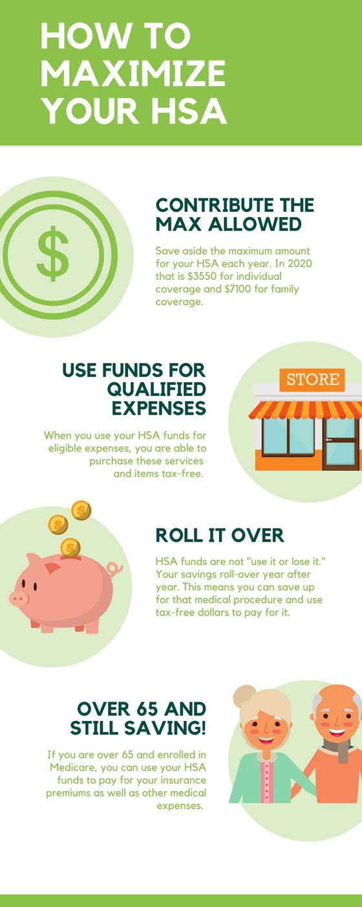
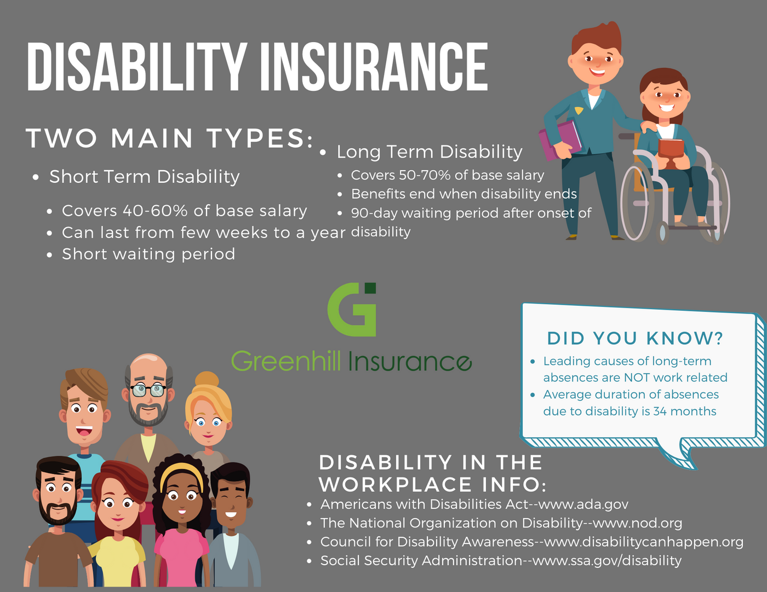
INFOGRAPHICS

Slide 6


BENEFITS VIDEO CONTENT
Our brain loves video because it is
programmed to retain visual content better than a page loaded with
words.
According to studies, the average viewer remembers 95% of a message when it is watched, whereas only 10% when read.

Slide 7
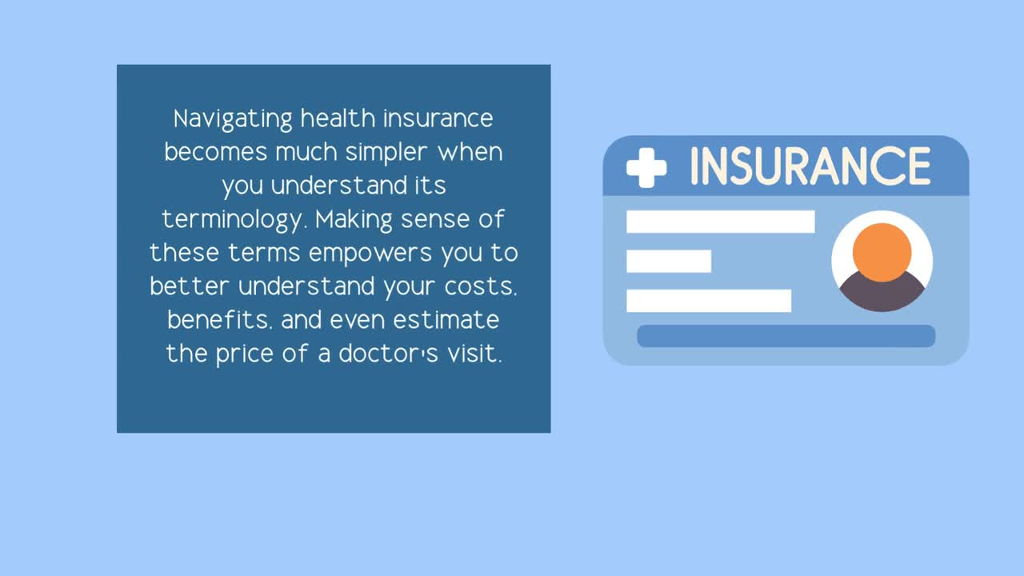
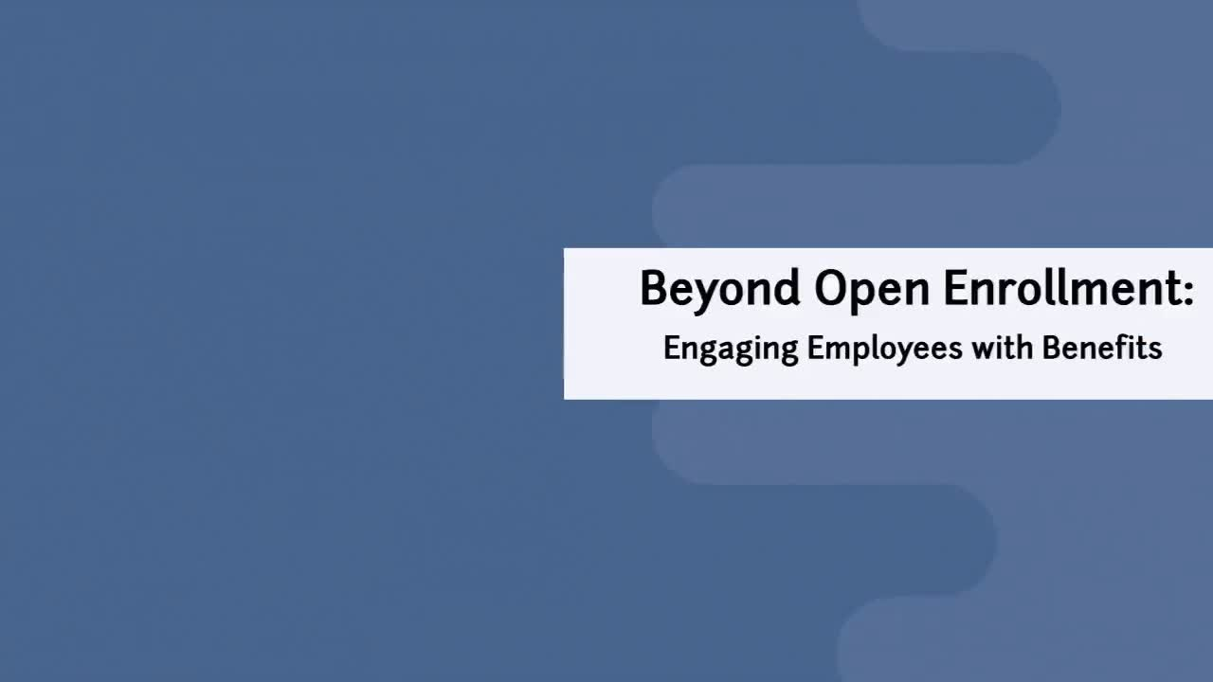
60-90 SECONDS FOR KEY POINT
90-120 FOR SIMPLE TRAINING
  MUSIC
  VOICE-OVER
  VENDOR OPTIONS

Slide 8


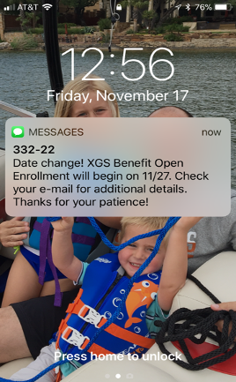
TEXT MESSAGING
TEXT MESSAGING FOR EMPLOYEE COMMUNICATIONS
98% open rate
45% REPLY RATE
**EMAIL has only 20% open and only 6% reply.

Slide 9
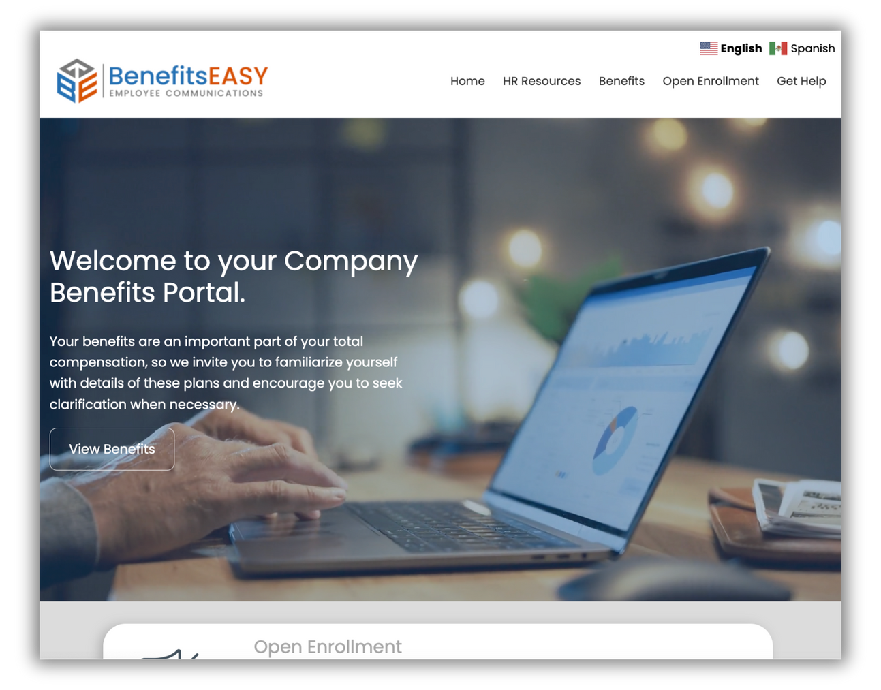
GREATER REACH - GET ONLINE!
Online Portal / Intranet / Ben Admin
Keys to success
Branded to each employer to provide a site easy for employees to adopt
Benefit plans, HR docs, and HR Resources Online 24/7
Monthly updated employee education videos
Multi-language option available

Slide 10

BONUS TIP!
GREAT CLIENT COMMUNICATION SHOULD
AGENCY MARKETING!!
FUEL

Slide 11
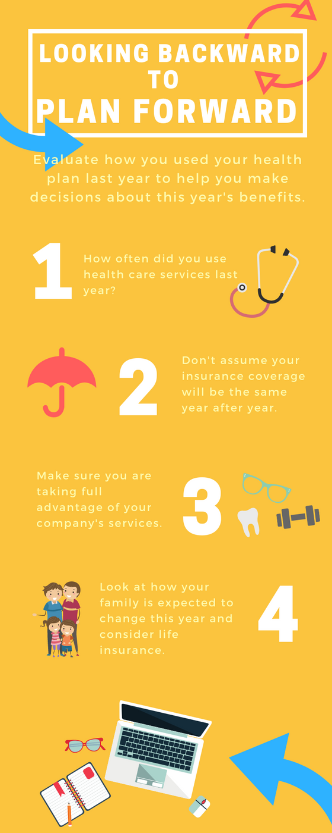

OPEN LINES OF
COMMUNICATION
GET BETTER UNDERSTANDING AND EDUCATION OF BENEFIT PLANS FOR EMPLOYEES
THINK SOCIAL!!
  Communicate in a way that already makes sense to people.
  Create a benefit communication strategy for the whole year.
  Support next year's open enrollment now.

Slide 12

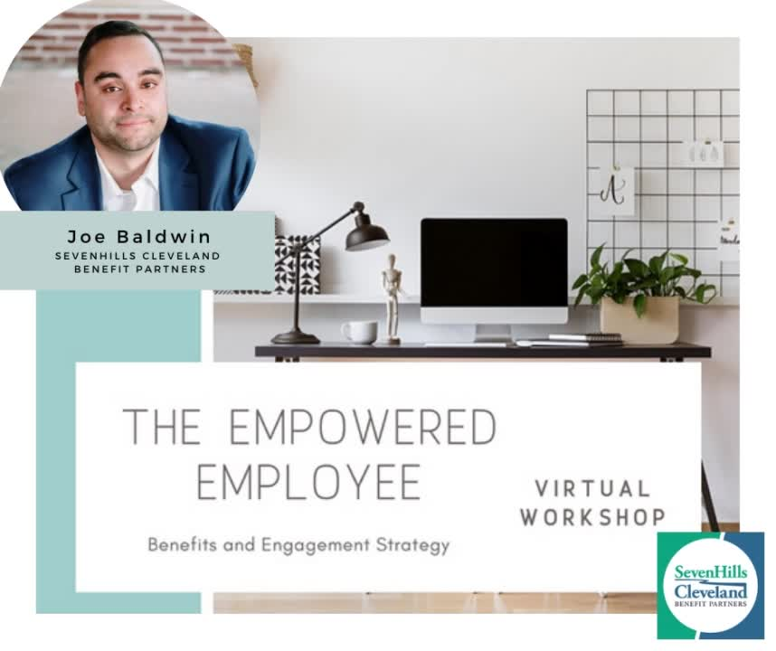

Slide 13

QUESTIONS?
Contact us anytime to get more ideas, strategies and examples of how we can help improve your employee communications today.

